Slide 1
Corona Virus Case Study
By: Pratiksha Saheb

Slide 2
Agenda
Objectives
Backgrounds
Key findings
Data Cleaning and Preparation
Dataset

Slide 3
Objective
To analyze a coronavirus dataset and derive meaningful insights to understand the spread and impact of the virus. Through data-driven analysis, we aim to provide valuable insights that can inform decision-making and response efforts in combating the pandemic.

Slide 4
Background
The coronavirus (COVID-19) pandemic has emerged as one of the most significant global health crises in modern history, profoundly affecting public health, economies, and societies worldwide. Since its initial emergence in late 2019, the pandemic has presented unprecedented challenges and necessitated urgent responses from governments, healthcare systems, and communities.
The pandemic, caused by the novel coronavirus SARS-CoV-2, has rapidly spread across continents, leading to widespread transmission and severe health consequences.

Slide 5
Key Findings
Maximum Monthly averages for confirmed cases (3060), deaths(60), and recoveries(1921) found in December month ,followed by November, April and October providing insights into the average trends and patterns observed over time.
Most frequent values for confirmed cases(316), and deaths(528) found in March month and most recovered cases(279) found in may month.
Maximum confirmed(823225) and recovered(1123456) cases found in year 2020 and maximum death(7374) occurred in 2021.

Slide 6
Key Findings
May has the greatest variance and standard deviation for death cases, it implies that there were significant fluctuations or variability in the number of deaths reported during that month.
December is the month with the greatest variance and standard deviation for recovered cases, it suggests significant variability or spread in the number of recoveries reported during that month compared to other months.
Afghanistan found the highest confirmed cases and lowest number of death cases.
Top 5 highest recovered countries are Argentina, Austria Algeria, Thailand and Australia.

Slide 7
Data Methedology
The corona virus database does not contain any null values in any column.
There is no duplicates row found in datasets
Coronavirus database contain 78386 rows and 8 columns.
The start date of data set is 2020-01-02 and end date is 2021-12-06.
The total number of months present in the dataset is 12, providing context on the duration of the analysis period.
The total number of year present in data set is 2020 and 2021

Slide 8
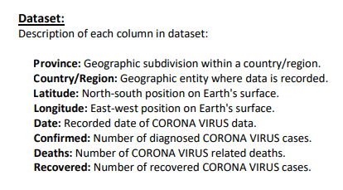
Data Set

Slide 9
Thank You

